Slide 1
7 Impact analysis (IA)
Initiation
Concept Location
Determines the strategy and impact of change
Classes identified in concept location make up the initial impact set
Class dependencies are analyzed, and impacted classes are added to the impact set
Produces estimated impact set
Impact Analysis
V
E
R
I
F
I
C
A
T
I
O
N
Prefactoring
Actualization
Postfactoring
Conclusion
© 2012 by Václav Rajlich

Slide 2
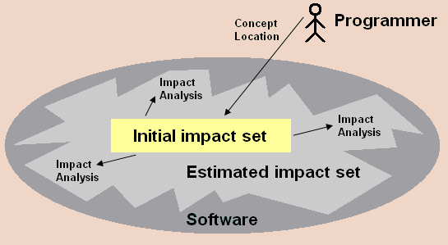
Initial and estimated impact set
© 2012 by Václav Rajlich

Slide 3
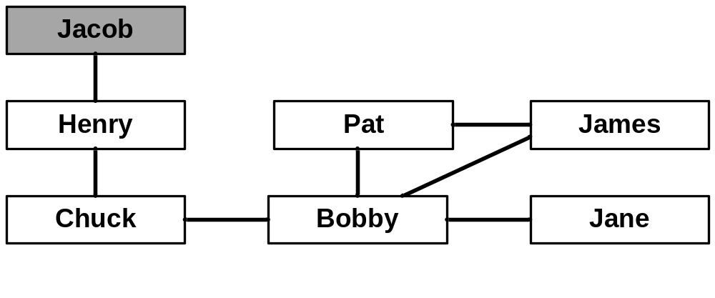
Example personal schedules
(story on page 107)
© 2012 by Václav Rajlich

Slide 4
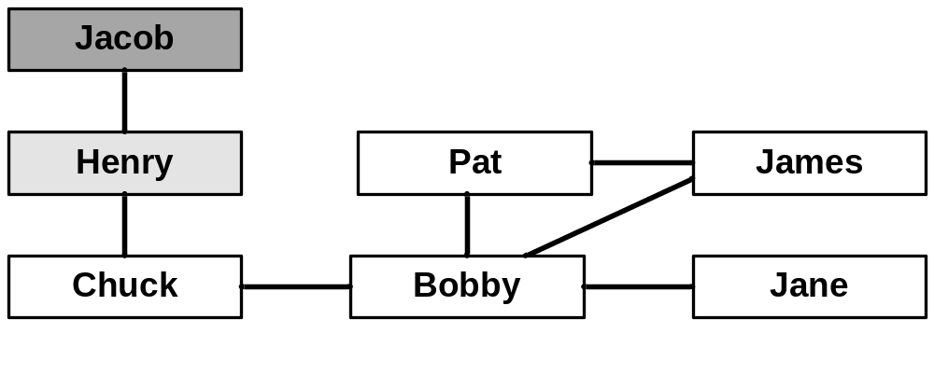
Example personal schedules
(story on page 107)
© 2012 by Václav Rajlich

Slide 5

Example personal schedules
(story on page 107)
© 2012 by Václav Rajlich

Slide 6
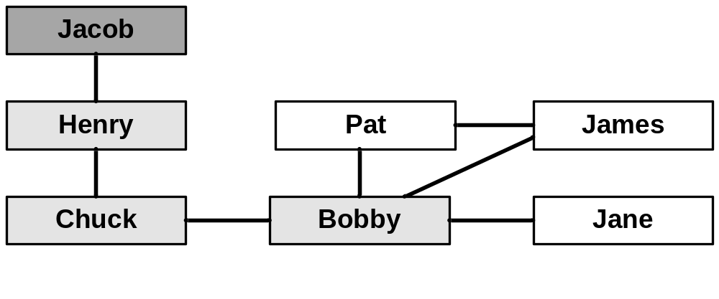
Example personal schedules
(story on page 107)
© 2012 by Václav Rajlich

Slide 7
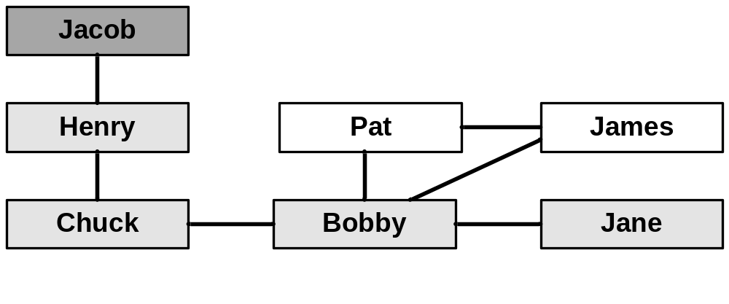
Example personal schedules
(story on page 107)
© 2012 by Václav Rajlich

Slide 8
Point of Sale Change Request
Record cashier sessions
A cashier session
  total cash and all sales
  during the time between the cashier logging in and out.
© 2012 by Václav Rajlich

Slide 9
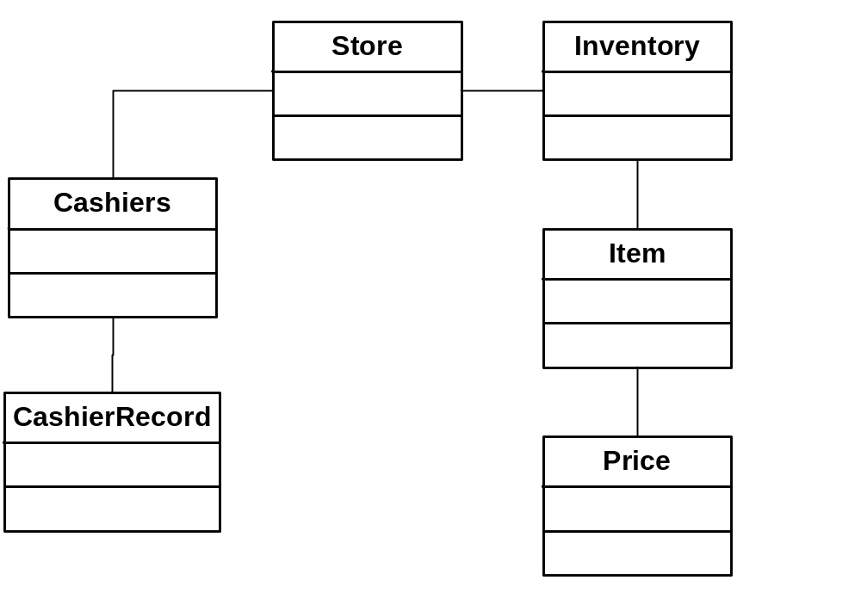
Example: Point of Sale
© 2012 by Václav Rajlich

Slide 10
Class interactions
Two classes interact if the have something in common
  One depends on the other
    There is a contract between them
  They coordinate
    They share the same coding, schedule, etc.
Interactions propagate change
  In both directions
    From A to B or from B to A
© 2012 by Václav Rajlich

Slide 11
Class Interaction Graph
G = (X,I)
  G … set of classes
  I … set of interactions
Neighborhood of class A
  N(A) = {B | (A,B) ∈ I}
© 2012 by Václav Rajlich

Slide 12
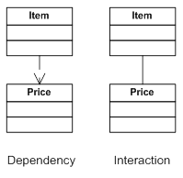
Interactions caused by dependencies
© 2012 by Václav Rajlich

Slide 13
Coordination
class C
{
A a; //gets the color code
B b; //paints the screen
void foo()
{ b.paint(a.get());
}
};
© 2012 by Václav Rajlich

Slide 14
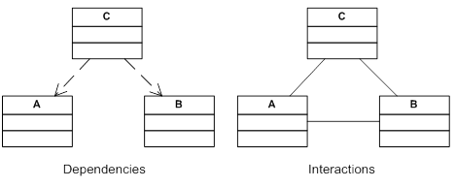
Dependency diagram, Interaction diagram
© 2012 by Václav Rajlich

Slide 15
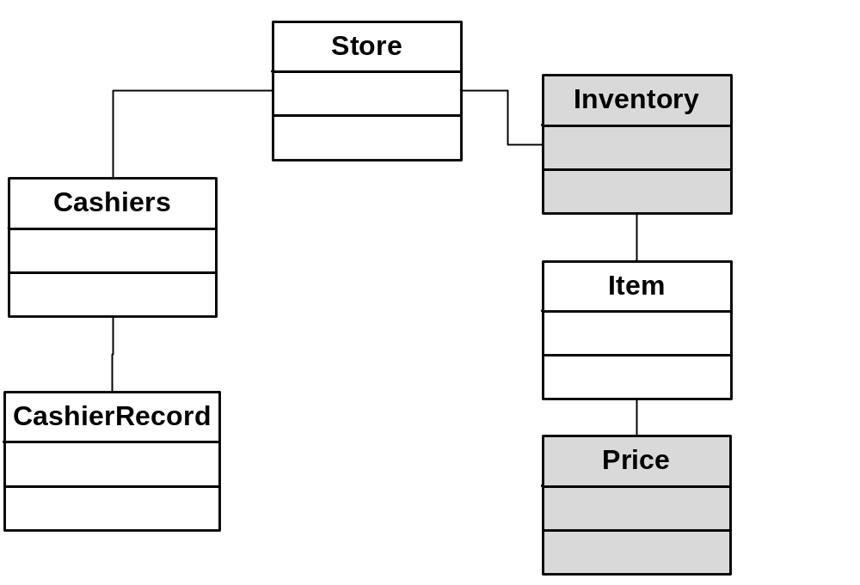
Neighborhood of Item
© 2012 by Václav Rajlich

Slide 16
Status of components (marks)
Blank | The class was never inspected and is not scheduled for an inspection.
Changed | The programmers inspected the class and found that it is impacted by the change
Unchanged | The programmers inspected the class and found that it is not impacted by the change.
Next | The class is scheduled for inspection
© 2012 by Václav Rajlich

Slide 17
A simplified IA process
Create interaction diagram and mark all classes as BLANK
Mark the class located during concept location as CHANGED
Mark all BLANK neighbors as NEXT
[No]
Are there any classes
marked as NEXT?
[Yes]
Select a class
among the classes
marked as NEXT.
What is the
new mark
for this class?
Mark class as UNCHANGED
[UNCHANGED]
Mark class as CHANGED
[CHANGED]
© 2012 by Václav Rajlich

Slide 18
Interactive IA
G
F
L
Main
B
E
C
A
K
J
H
D
N
O
I
P
Color codes
Unknown
Changed
Next
Unchanged

Slide 19
Propagating class: Mailman
John loaned money to Paul
  needs the money back
  His situation changed
John writes a letter to Paul
  Mailman takes the letter from John to Paul
  Paul must take a part-time job
  a big change that propagated from John to Paul
© 2012 by Václav Rajlich

Slide 20
Interactions
John interacts with the mailman
the mailman interact with Paul
The change originated with John and propagates through the mailman to Paul.
  mailman is in the middle of the propagation
    he does not have to change anything
    he just keeps delivering the letters from one person to another.
© 2012 by Václav Rajlich

Slide 21
IA including propagating classes
Create interaction diagram and mark all classes as BLANK
Mark the class located during concept location as CHANGED
Mark all BLANK neighbors as NEXT
[No]
Are there any classes
marked as NEXT?
[Yes]
Select a class
marked as NEXT.
What is the
new mark
for this class?
Mark class as INSPECTED
[UNCHANGED]
Mark class as PROPAGATING
[PROPAGATING]
[CHANGED]
Mark class as CHANGED
© 2012 by Václav Rajlich

Slide 22
Iterative IA
H
B
E
I
F
C
A
D
J
G
L
K
Color codes
Unknown
Changed
To be inspected
Inspected and unchanged
Propagating

Slide 23
Alternatives in software change
Program displaying a temperature in Fahrenheit
  change request: display it in Celsius
Two separate locations deal with temperature
  sensor data converted to the temperature
  temperature displayed to the user
The change can be done in either place
  impact analysis weights these alternatives
© 2012 by Václav Rajlich

Slide 24
The criteria
Required effort of the change
Clarity of the resulting code
Often, these two criteria contradict each other
  it is easier to adjust the user interface
  it is better to have all calculations of the temperature in one place
Conflict between short-term and long-term goals
© 2012 by Václav Rajlich

Slide 25
Interactive IA
Computer
Programmer
Create interaction diagram and mark all classes as BLANK
Mark the class located during concept location as CHANGED
Mark all BLANK neighbors as NEXT
[No]
Are there any classes
marked as NEXT?
[Yes]
Select a class
marked as NEXT.
What is the
new mark
for this class?
Mark class as INSPECTED
[INSPECTED]
Mark class as PROPAGATING
[PROPAGATING]
[CHANGED]
Mark class as CHANGED
© 2012 by Václav Rajlich

Slide 26
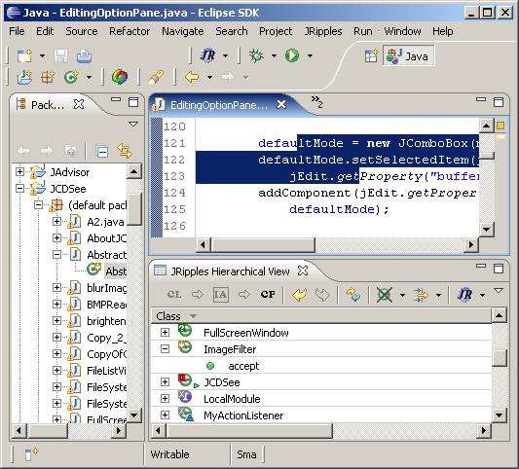
Tool support: JRipples
Automatically identifies and suggests components to be inspected Next
Keeps track of
  What was done (Changed,
  Propagating, Unchanged)
  What needs to be done
  (Next)
Eclipse plug-in
  Java
  15,000 LOC
  150 Classes
  2,500 Methods
http://jripples.sourceforge.net
© 2012 by Václav Rajlich

Slide 27
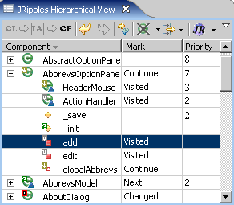
JRipples GUI
© 2012 by Václav Rajlich

Slide 28
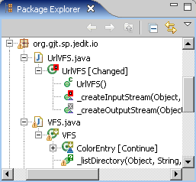
JRipples marks and Eclipse
© 2012 by Václav Rajlich

